Slide 1

Python for data analytics capstone project Analysis of New York State's Distributed Solar Projects (2000–Present)
George Louis Jr
April 2025

Slide 2

Why solar power?
My interest in solar power is driven by a combination of factors. Solar energy offers a sustainable solution to reduce greenhouse gas emissions, while also creating economic opportunities through cost savings, job growth, and government incentives like the Power New York Act of 2011. It enhances energy independence by decentralizing power production and promotes innovation through advancements in technology and integration with smart systems. From a social and ethical standpoint, solar energy supports global access to clean power and aligns with values of sustainability. As someone with a background in property management and real estate, I see solar adoption as increasingly relevant in modern development and urban planning—making it a valuable area for continued growth and impact.

Slide 3

Data Source: New York State Distributed Solar Projects
ny.data.gov
Source: New York State Open Data Portal
Access Link: data.ny.gov
Dataset Name: Statewide Distributed Solar Projects: Beginning 2000
Data Dictionary: Data Dictionary Link PDF
Scope: The scope of this analysis examines the growth, distribution
and efficiency of solar energy projects across New York State from 2000 to 2024. The analysis has a focus on the number of projects and their estimated annual energy production.

Slide 4
Data SET Technical OVERVIEW
This dataset contains detailed information with
244,056 Rows
on distributed solar energy projects across New York State. It includes
17 Columns
covering technical specifications, project identifiers, locations, and energy output.
Python was implemented for data analysis and visualization.
The following libraries were used:
Pandas For data manipulation and analysis
Numpy For numerical operations
Matplotlib For plotting graphs
Seaborn For enhanced data visualizations
To support time analysis, the column Interconnection Date was successfully converted to datetime format.
Energy Storage System Size information was removed due to 97.85% of the data being unavailable.
2025 data was removed due to only having 3 months worth of data.
There was no data for Manhattan in the dataset.

Slide 5
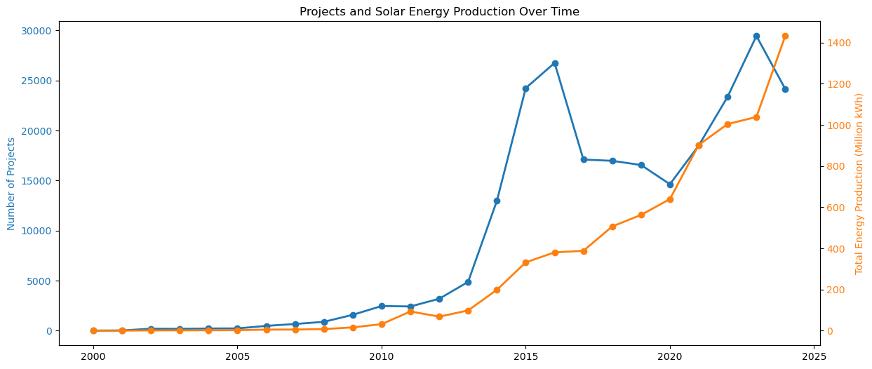
The above chart illustrates the relationship between the growth in the number of solar projects and the total energy production (in millions of kWh) over time. As more projects are initiated, the energy production also increases, demonstrating the positive impact of expanding solar energy infrastructure.
Even with there being a dip between 2017-2020, the energy production was steadily increasing.

Slide 6
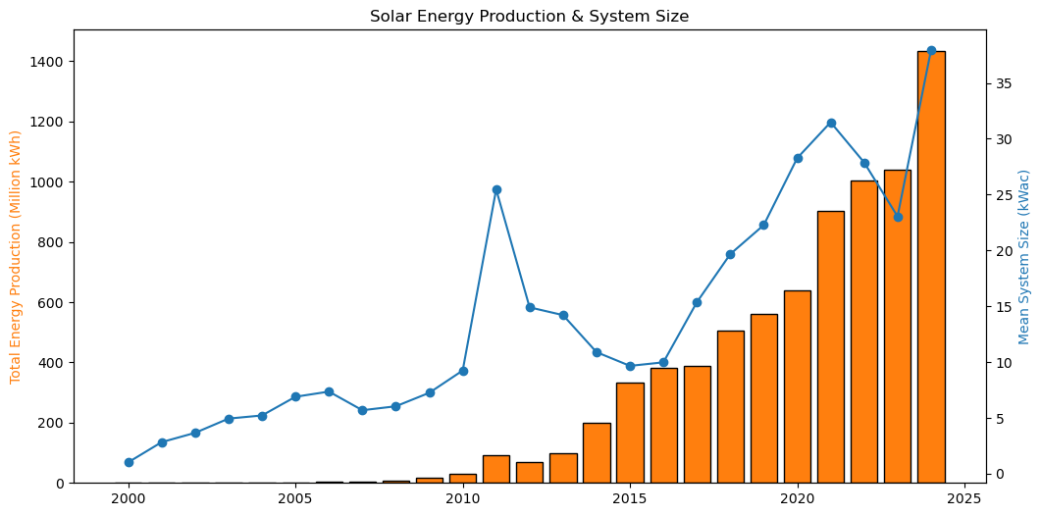
This chart suggests that newer solar systems are generally larger and more efficient, contributing to the higher energy output, specifically starting in 2011,with the passing of the Power New York Act . Compared to the previous chart, this shows that even if the total number of projects decreases, the size and efficiency has been increasing over time. Overall, the data tells us that solar energy infrastructure is not only expanding in terms of the number of projects but also in terms of system capacity, leading to a significant increase in total energy production.

Slide 7
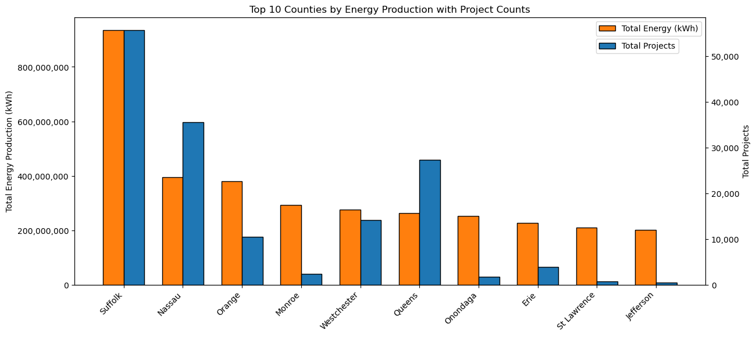
Some counties are producing more solar energy with fewer projects likely because their systems are larger, more efficient, or better situated. In these areas, instead of many small residential panels, there may be large-scale solar farms or commercial installations that generate much more energy per project. These counties might also have more open land available, making it easier to build big systems without space limitations.

Slide 8
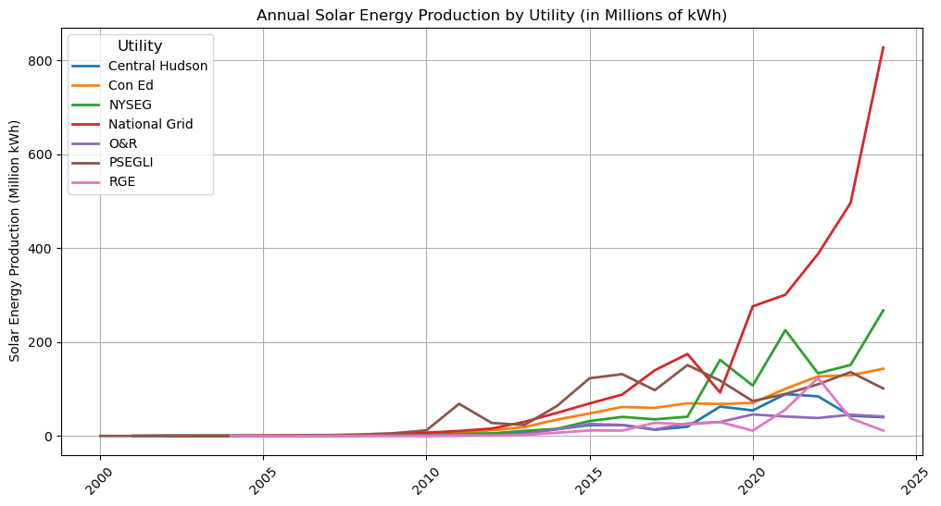
In 2024, National Grid's energy production was over 800 million kWh, showing a major boost in solar capacity. This steady growth indicates a shift towards larger and more efficient solar installations over the years, with New York making significant strides in renewable energy adoption across multiple regions. The trend also suggests that as technology improves and more projects come online, solar energy is becoming a larger and more integral part of the state's energy mix.

Slide 9
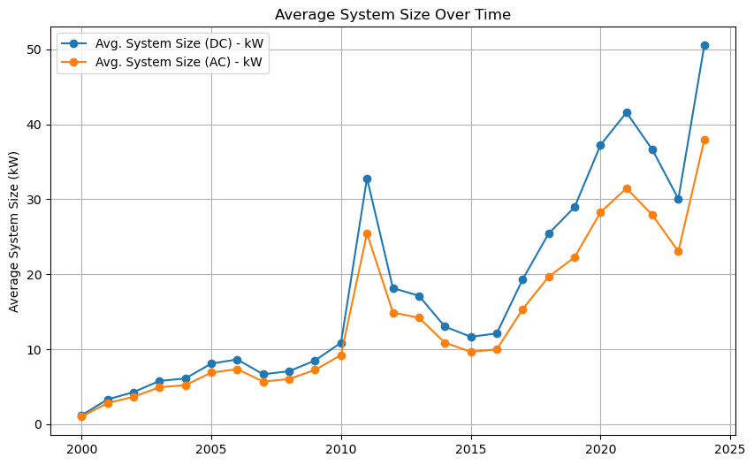
Over the years, solar systems have grown significantly in both size and energy output. In the early 2000s, average systems were small and produced only a few thousand kilowatt-hours. By 2024, system sizes had grown to over 50 kW (DC) and nearly 38 kW (AC), with average energy production nearing 59,000 kWh. The difference between DC and AC matters—solar panels generate direct current (DC), but that gets converted to alternating current (AC) for home and grid use, with a bit of energy lost in the process. This steady increase shows how solar technology has become more efficient and powerful over time.

Slide 10

conclusion
The analysis shows significant growth of solar energy production in New York State over time, with a clear trend towards larger, more efficient systems. The steady increase in both the number of solar projects and their energy output can be attributed to advances in solar technology and the influence of policy changes like the Power New York Act. Some counties are producing more energy with fewer projects, likely due to larger installations such as solar farms or better land availability. Over the years, solar systems have become much larger and more efficient, with average system sizes and energy production per system increasing significantly. This data answers several key questions: how solar energy production has changed, what factors have driven this growth, why some counties are more efficient than others, and how solar systems have evolved in size and capacity. Overall, the data suggests that solar energy will continue to grow in New York’s energy mix, with increasing efficiency and capacity driving the future of renewable energy in the state.

